Slide 1
Requirements
EPFL Software Engineering

Slide 2


Slide 3



Slide 4


Slide 5
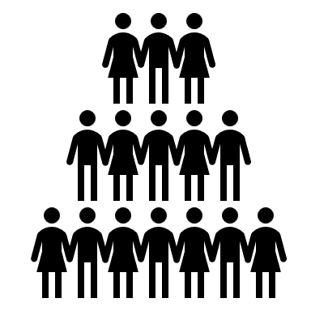

Slide 6


Slide 7


Slide 8


Slide 9
Objectives
Define user requirements
Formalize personas and user stories
Develop software based on requirements
Understand implicit vs explicit requirements

Slide 10
What are requirements?

Slide 11


Slide 12
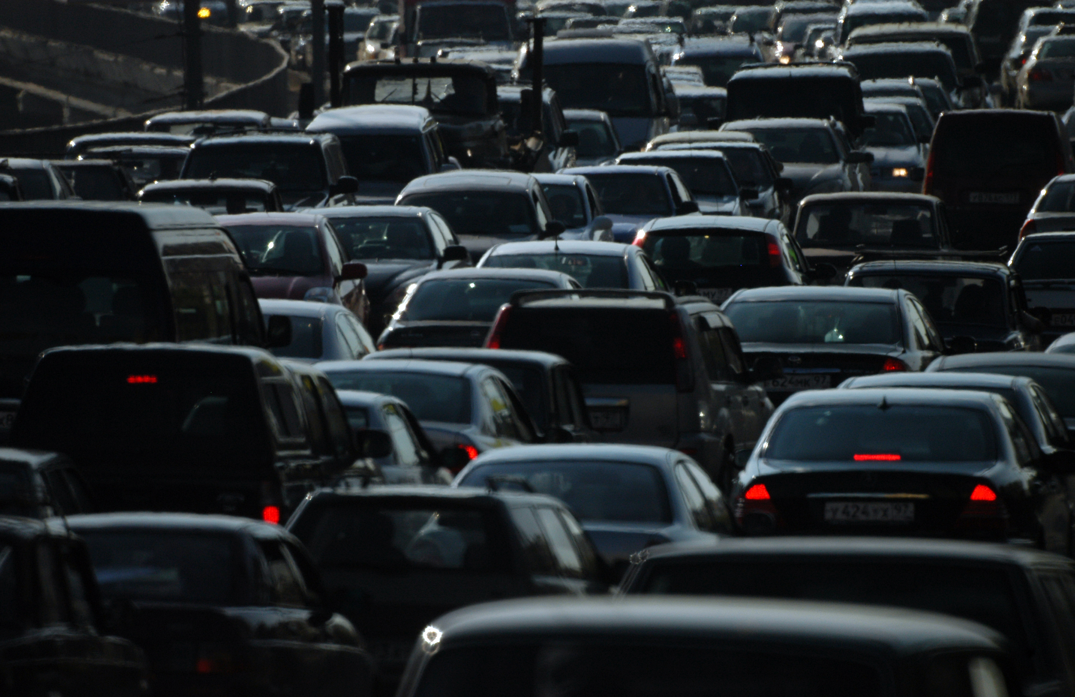

Slide 13
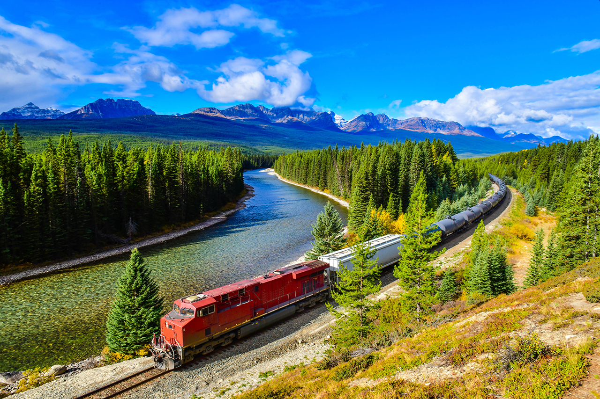

Slide 14
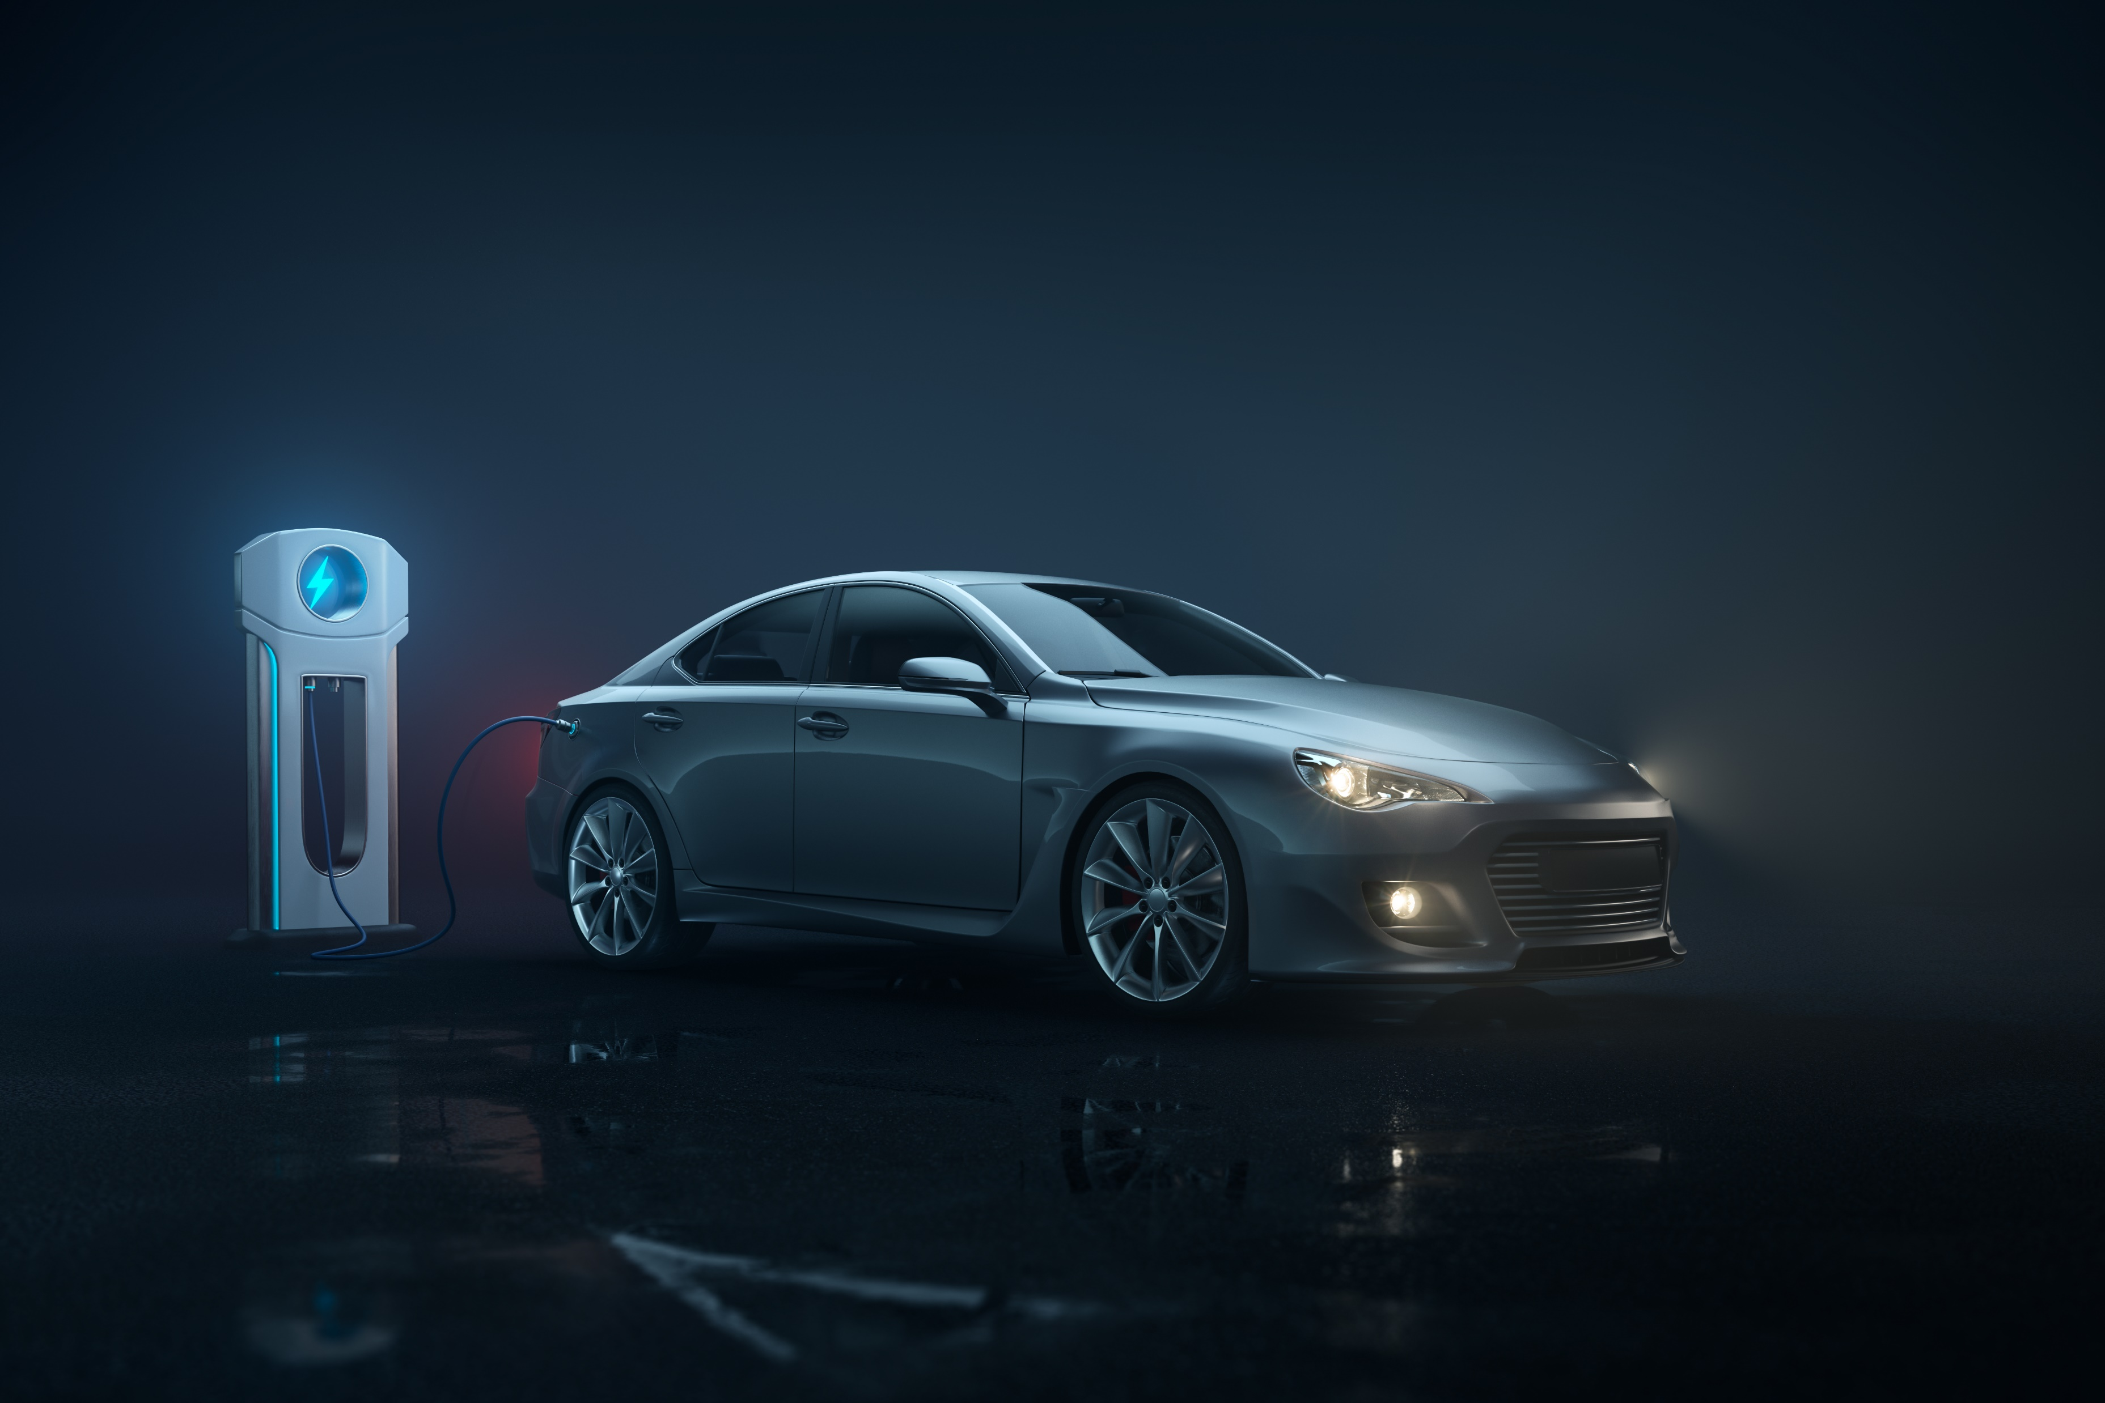

Slide 15
Requirements
= user needs
≠ implementation

Slide 16

“Functional” requirements

Slide 17



“Non-functional” requirements
= “quality attributes”
…

Slide 18
Defining requirements
Vague
Specific

Slide 19





Needs, not wants

Slide 20


Needs, not wants

Slide 21
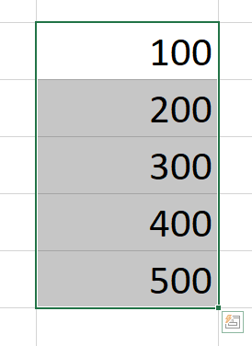
Ambiguities

Slide 22
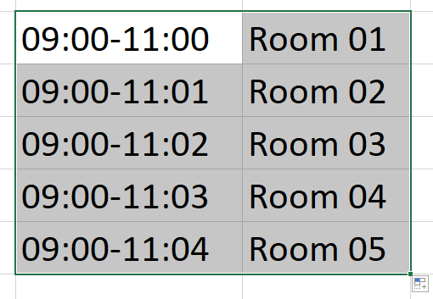
Ambiguities

Slide 23
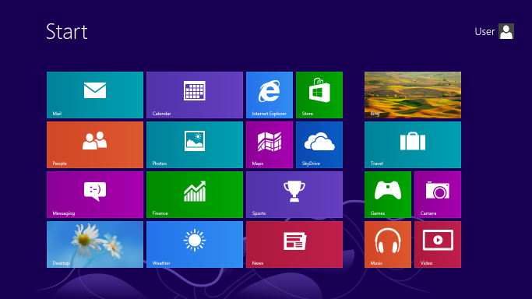
Beware
Microsoft Windows 8 start screen.

Slide 24
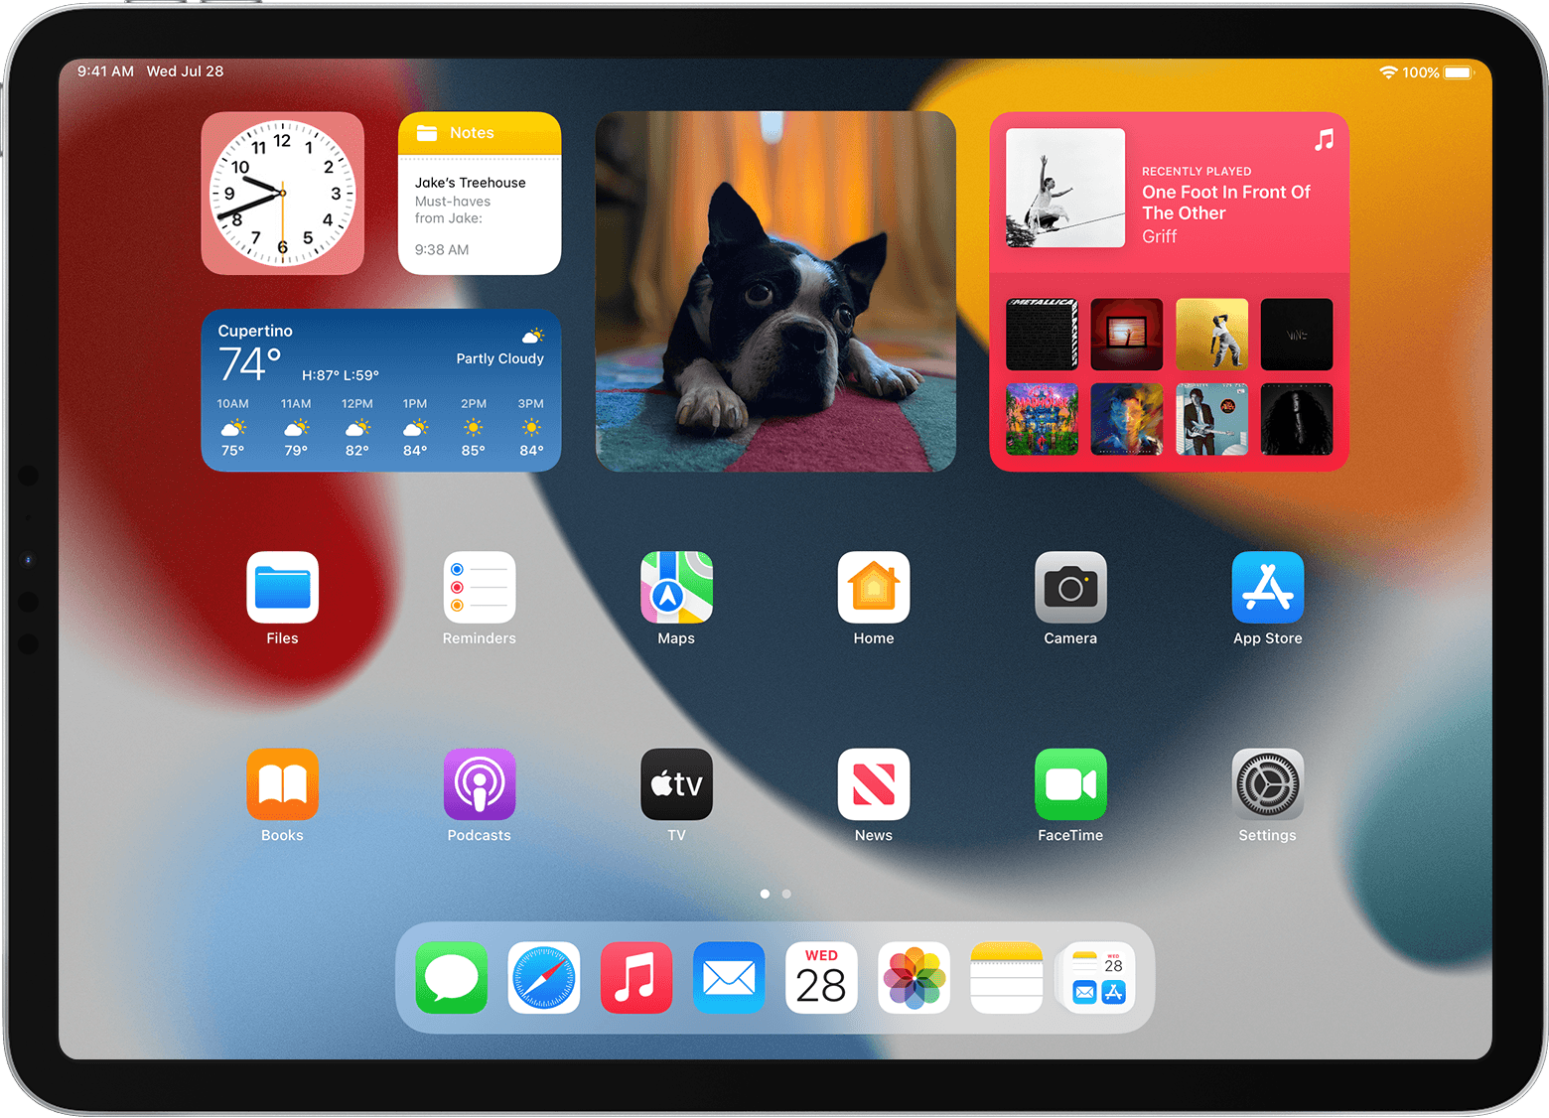
But…
“Use widgets on your iPad”, https://support.apple.com/en-us/HT211328

Slide 25
Requirements are for humans
Not objective,
exact,
…

Slide 26
How can we formalize requirements?

Slide 27






Problem

Slide 28
Goals
Who are users?
What do they need?

Slide 29
Who?

Slide 30








Slide 32
“Personas”
Abstract people representing a group

Slide 33

Example

Slide 34
“Alice”
Student, uses the app in public transport
→ pre-downloading podcasts
→ listening with screen turned off

Slide 35
“Bob”
Pensioner, uses the app while cooking, cleaning, …
→ voice-based commands
→ ease of use, no technical jargon

Slide 36
“Carol”
Hacker, listens to pirated music
→ upload music from a PC
… really?

Slide 37

Avoid over-abstracting

Slide 38
Exercise
What personas could a video chat app have?
Notes:
6min thinking + 1min answers

Slide 39




What?

Slide 40



Context?

Slide 41
“User stories”
As a …,
I want to …,
So that …

Slide 42
Example
As a student,
I want to watch course recordings,
So that I can catch up after an illness

Slide 43

“As a…”

Slide 44
“I want to…”

Slide 45
“So that…”

Slide 46
Example

Slide 47
As Alice,
I want to download podcasts in advance,
So that I can save mobile data

Slide 48
As a commuter by car,
I want to download podcasts in advance,
So that I can use the app without mobile data

Slide 49
As Bob,
I want to control the app with my voice,
So that I can use it while cooking

Slide 50
As a mechanic,
I want to control the app with my voice,
So that I can use it without looking

Slide 51
As a quadriplegic,
I want to control the app with my voice,
So that I can use it

Slide 52
“INVEST”
Independent
Negotiable
Valuable
Estimable
Small
Testable

Slide 53
Exercise
What user stories could a video chat app have?
As a … I want to … So that …
Notes:
6min thinking + 1min answers

Slide 54
Good user story?
“As a user,
I want to log in quickly,
So that I don’t lose time”
Too vague

Slide 55
“As a Google account owner,
I want to log in with my Gmail address”
OK, implicit reason

Slide 56
“As a movie buff,
I want to view recommended movies at the top on a dark gray background with horizontal scroll”
Too specific

Slide 57
“As an occasional reader,
I want to see where I stopped last time,
So that I can continue reading”
Good!

Slide 58
“As a developer,
I want to improve the log in screen,
So that users can log in with Google accounts”
No!

Slide 59
How can we develop from requirements?

Slide 60




Problem

Slide 61
Validation
“Is this what users want?”
≠ verification

Slide 62

Prioritization
“Must have”, (“P0”)
“should have”, (“P1”)
“could have” (“P2”)
...

Slide 63


Image credit: Migros.ch

Slide 64


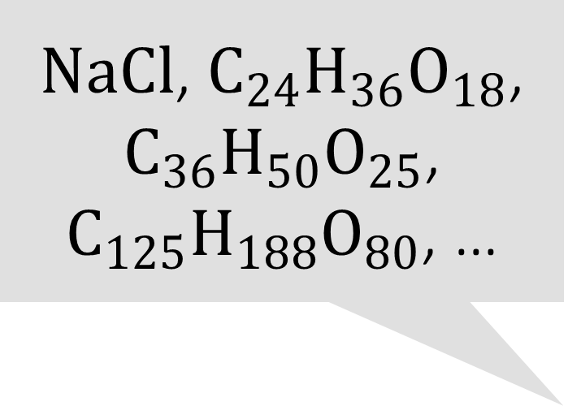
$NaCl$, $C_{24}H_{36}O_{18}$, $C_{36}H_{50}O_{25}$, $C_{125}H_{188}O_{80}$, …
“Salted caramel”

Slide 65
Goals
Common vocabulary: Domain-Driven Design
Integrating users: Behavior-Driven Development

Slide 66
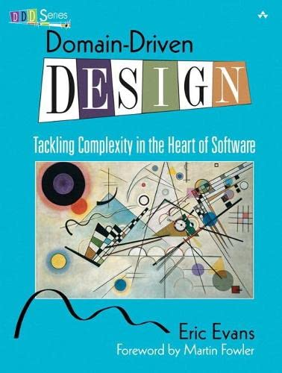
“Domain-Driven Design”
Eric Evans, 2003
Shared vocabulary between devs and users
Image credit: Amazon

Slide 67
class PrincipalFactory: def create(id): ...
“Login service” “Email”

Slide 68
principal is None
“Reject login”

Slide 69
class LoginService: def login(email): ...

Slide 70
When the email is invalid Then reject the login

Slide 71


What is a person?
Employees
Contractors
…
Customers
Suppliers
…
Students
Auditors
…

Slide 72

class Person {
String bankAccount;
List<String> allergies;
Map<Course, Integer> grades;
}

Slide 73

class Employee {
String bankAccount;
int yearsWorked;
...
}

Slide 74
class Employee {
static Employee get(String email) {
...
}
}

Slide 75
“Behavior-Driven Development”
Formalization of user stories into test scenarios
Given ...
When ...
Then ...

Slide 76
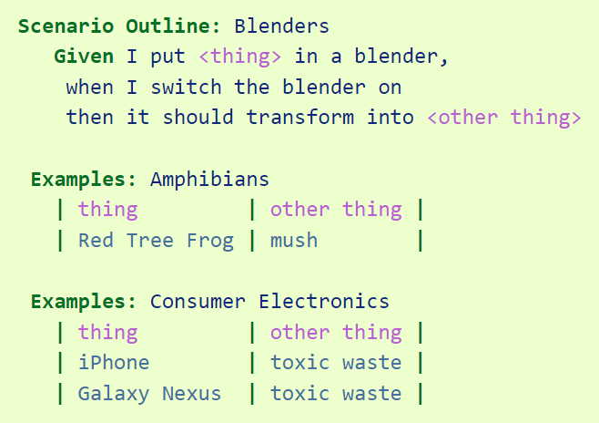
def put(thing): ...
def switch_on(): ...
def check(thing): ...
https://behave.readthedocs.io/en/stable/tutorial.html

Slide 77

Workflow
Given ...
When ...
Then ...
Given ...
When ...
Then ...

Slide 78
Exercise
What language + test scenarios for course registration?
Notes:
6min thinking + 1min answers

Slide 79
What implicit requirements do audiences have?

Slide 80







Slide 81
Concretely
Localization (“l10n”)
Internationalization (“i18n”)
Accessibility (“a11y”)

Slide 82


Slide 83
print("Hello " + user)
print(HELLO_TEXT + user)
print(hello_text(user))

Slide 84
Log in
Connexion
Notes:
(Full: “Connexion”)

Slide 85


Danube steamship company captain
Donaudampfschifffahrtsgesellschaftkapitän
Notes:
(Full: “Donaudampfschifffahrtsgesellschaftkapitän”)

Slide 86
EN FR
Edit the document Éditer le document
Edit the page Éditer la page
Edit the section Éditer la section

Slide 87
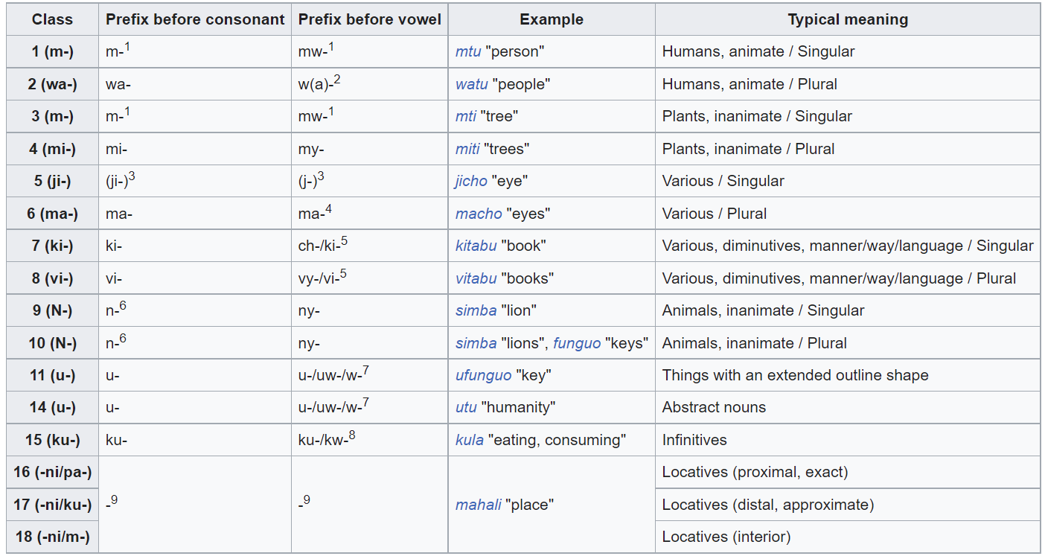
EN FR DE
SW
the le der
la die
das
Source: Wikipedia

Slide 88
EN FR
SL
1 volk
2 volkova
3 volkovi
4 volkovi
5 volkov
…
1 wolf 1 loup
2 wolves 2 loups
3 wolves 3 loups
… …

Slide 89
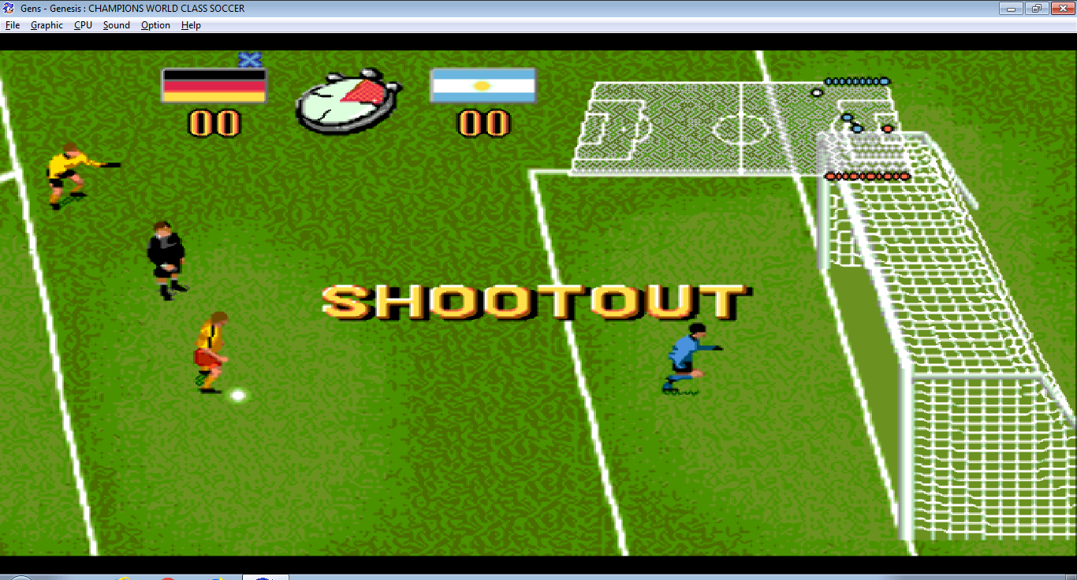
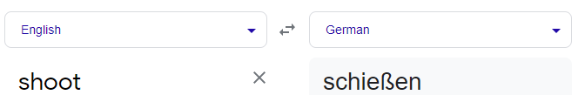
From “Champions World Class Soccer”

Slide 90
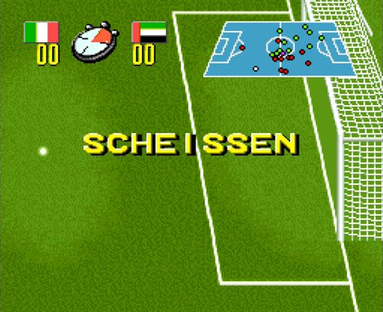
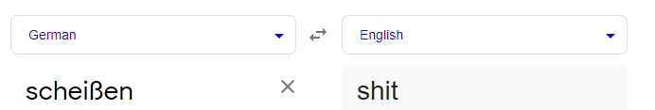

Slide 91



From “Grandia HD Collection”

Slide 92
Localization
Must be validated
You cannot know everything

Slide 93




?????

Slide 94
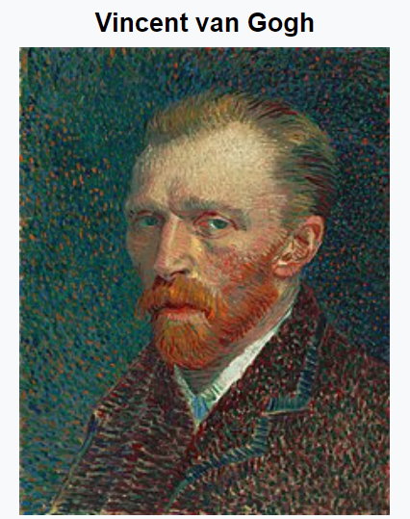



A B C … G
H … V W …
Image source: Wikipedia

Slide 95

“10/01”

Slide 96
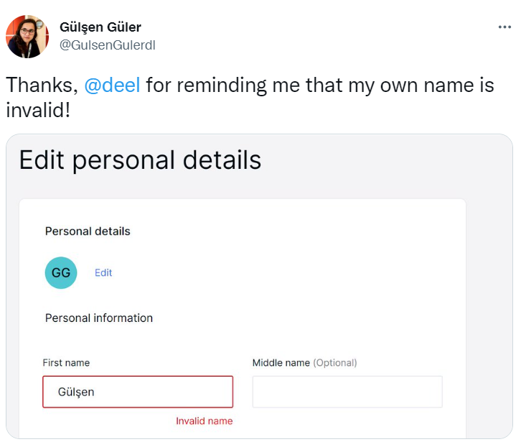
https://twitter.com/GulsenGulerdl/status/1492096311788769291

Slide 97
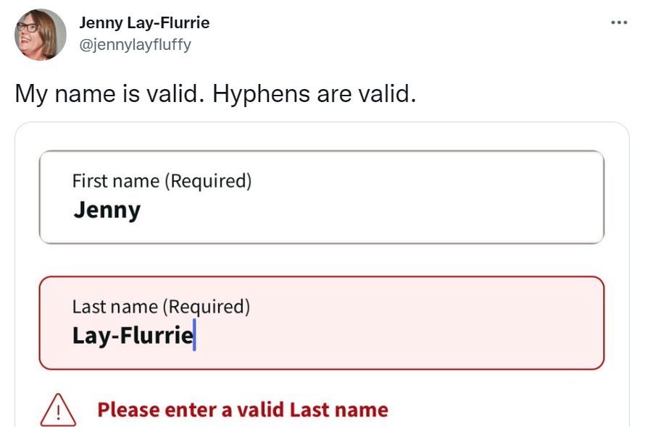
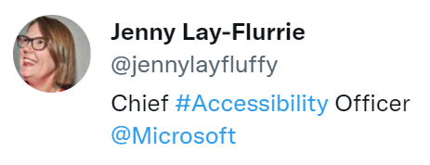
https://twitter.com/jennylayfluffy/status/1487262861617369091

Slide 98
Names are never “invalid”
Even… without a “family name”
with 1 letter
with >50 letters
with symbols, hyphens, etc.
…

Slide 99



December?

Slide 100
Internationalization
Must be validated
You cannot know everything

Slide 101


Accessibility

Slide 102



But also…

Slide 103

Why care?

Slide 104


Slide 105
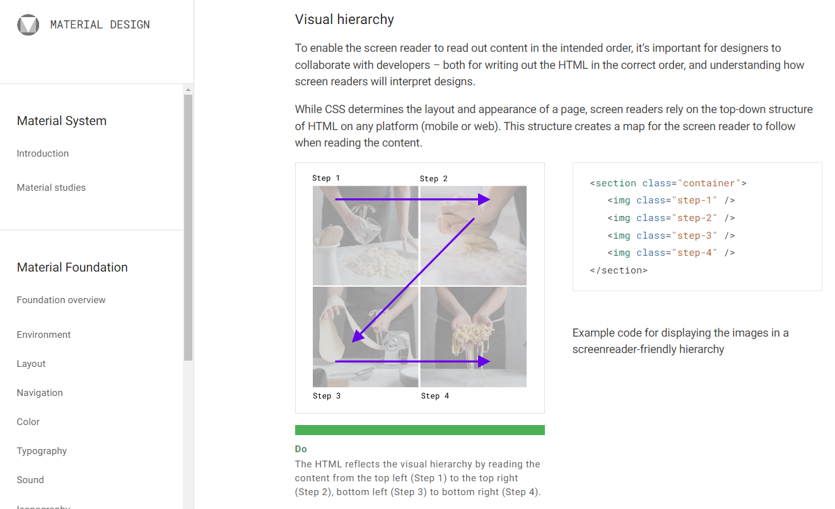
https://material.io/design/usability/accessibility.html

Slide 106
Are all requirements ethical?

Slide 107
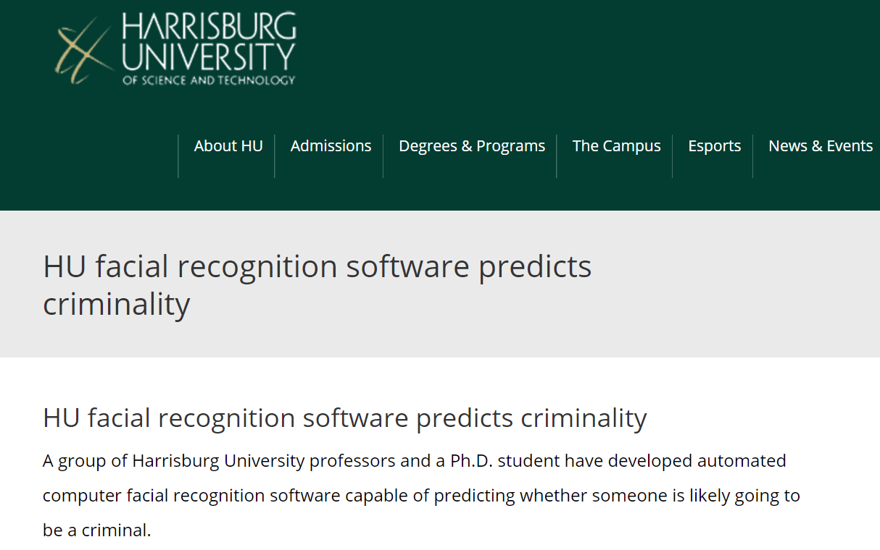
https://archive.ph/N1HVe

Slide 108
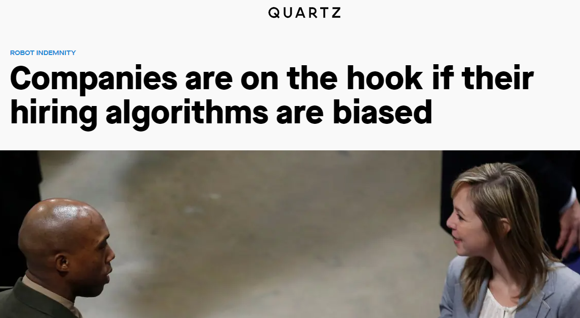
After the company trained the algorithm on 10 years of its own hiring data […] The word “women,” like in women’s sports, would cause the algorithm to specifically rank applicants lower.
Between 2014 and 2017 Amazon tried to build an algorithmic system to analyze resumes and suggest the best hires.
After an audit of the algorithm, the resume screening company found that the algorithm found two factors to be most indicative of job performance: their name was Jared, and whether they played high school lacrosse.
https://qz.com/1427621/companies-are-on-the-hook-if-their-hiring-algorithms-are-biased/

Slide 109




Slide 110
Summary
Defining and formalizing user needs: Requirements, personas, user stories
Developing based on requirements: Domain-driven design, behavior-driven dev.
Understanding implicit requirements: Localization, i18n, accessibility, ethics

